Slide 1

Complex State in React
Mary Shaw
Engineering Lead at FamilySearch
Over 25 years of Web Development

Slide 2

Complex React State Defined:
Many interconnected state changes in many React components

Slide 3
Why Does managing state well Matter?
The longer a product lives, the more maintenance matters.
Updating organized complex code is easier.
Well organized code is easier to test – and easier to refactor!

Slide 4
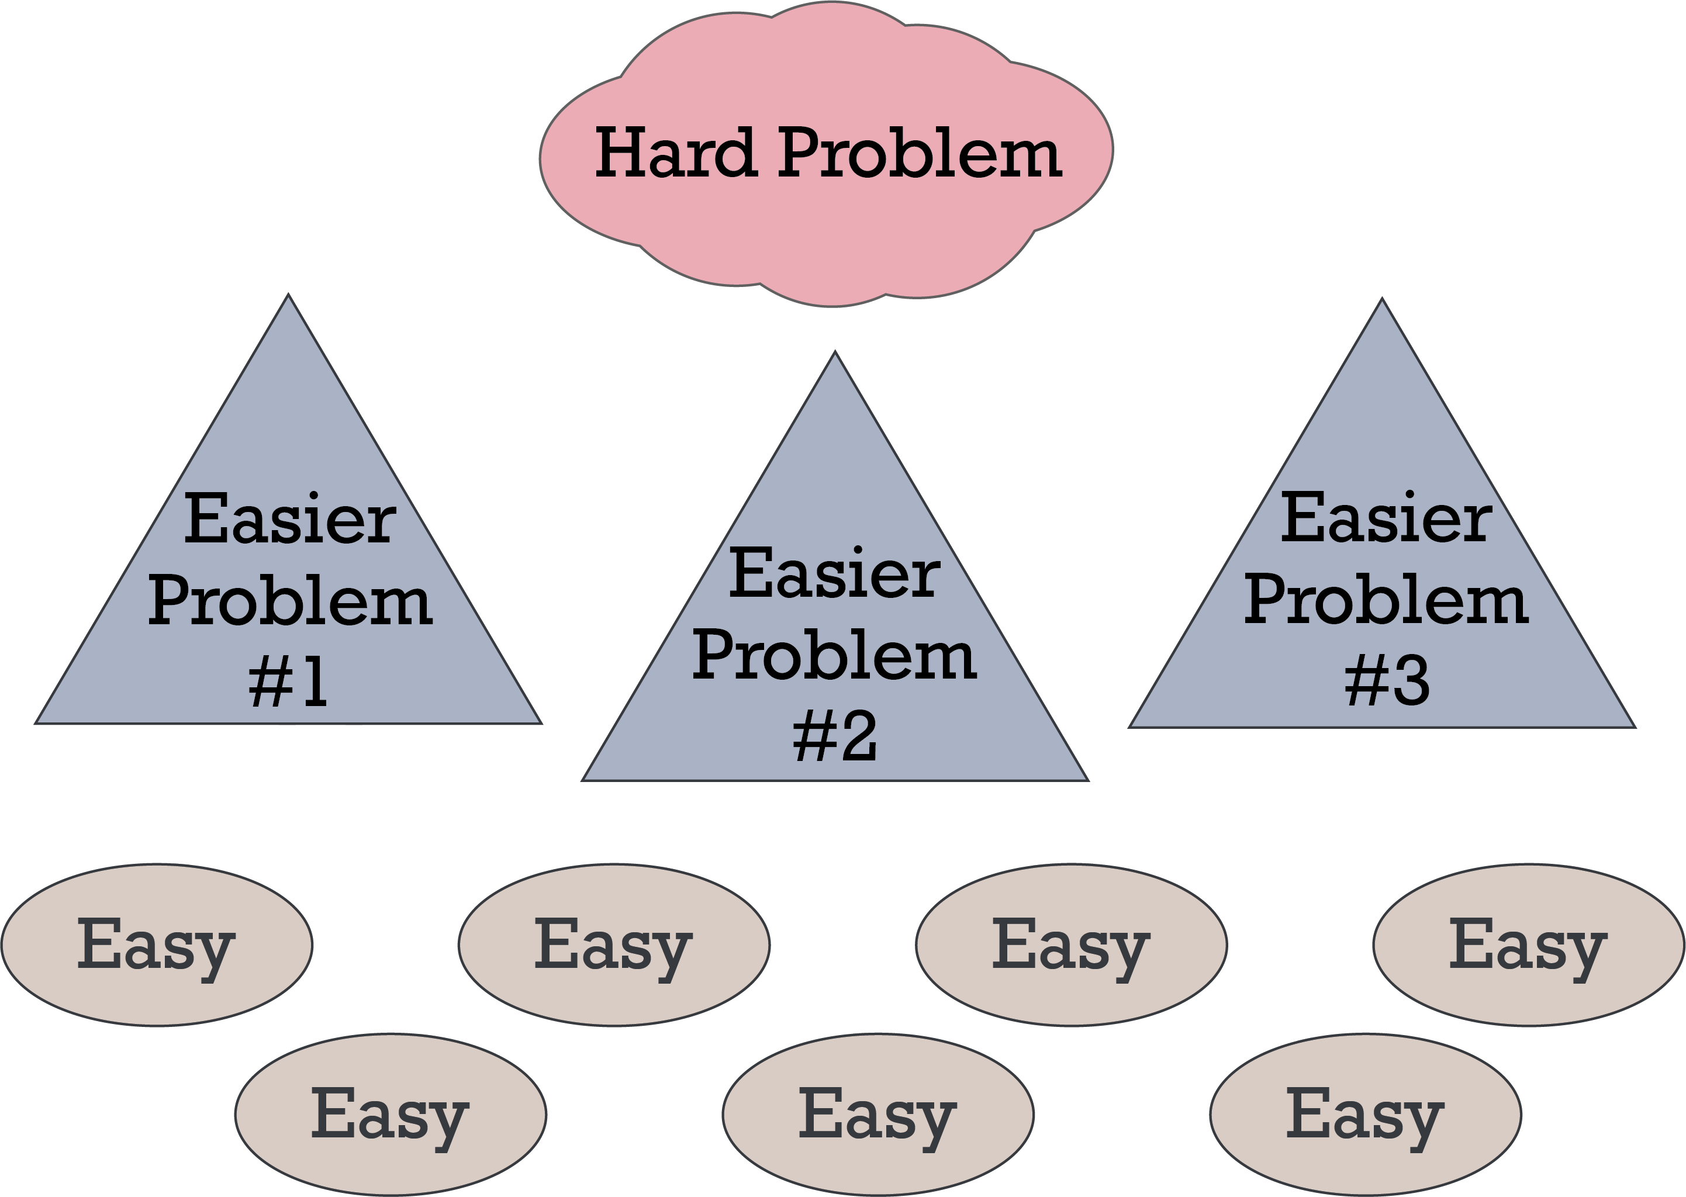
#1 Rule of Complex State: Break It Up!!

Slide 5
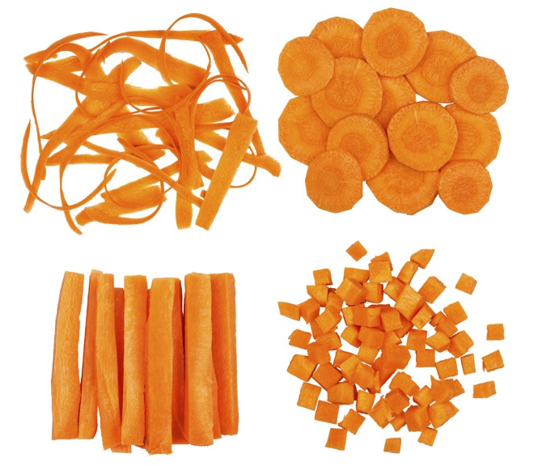
Breaking Up – or Breaking Down – “State”
There are many ways to break down a complex problem
The answers are not “one size fits all”
We’ll go over the building blocks
Then we’ll discuss combining them

Slide 6
State Building Blocks for Complex Apps
State Management
State Buckets
Composition

Slide 7
React State Management Building Blocks
Props
Derived Variables
UseState
Use-
Reducer

Slide 8
Props
Component parameters
function Welcome(props) { return <h1>Hello, {props.name}</h1> }
function Welcome({ name }) { return <h1>Hello, {name}</h1> }
Useful for passing state from one component to another

Slide 9
Derived Variables
… are derived from other state at render time
Reset every render
function Welcome({ name }) { const { t } = useTranslation() const message = t(`Hello, ${name}`) return <h1>{message}</h1> }
Cache and reset when
necessary using useMemo()
const collectionDetails = useMemo(() => { return getCollectionDetails(record) }, [record])
Useful when a variable only changes on render

Slide 10
useState
A state variable that can be modified outside of initial render
Default is only used on first render
Or until changed
export function StateExample() { const [state, setState] = useState(initialState)
return <InnerComponent state={state} /> }
Can be updated outside render cycle
Can be passed to lower components
Useful for simple scenarios with updates outside of render

Slide 11
useReducer
A state machine for more complex state
API intimidates some people, but it’s not that hard (once you learn!).
Useful for changing multiple interconnected variables in lock-step

Slide 12
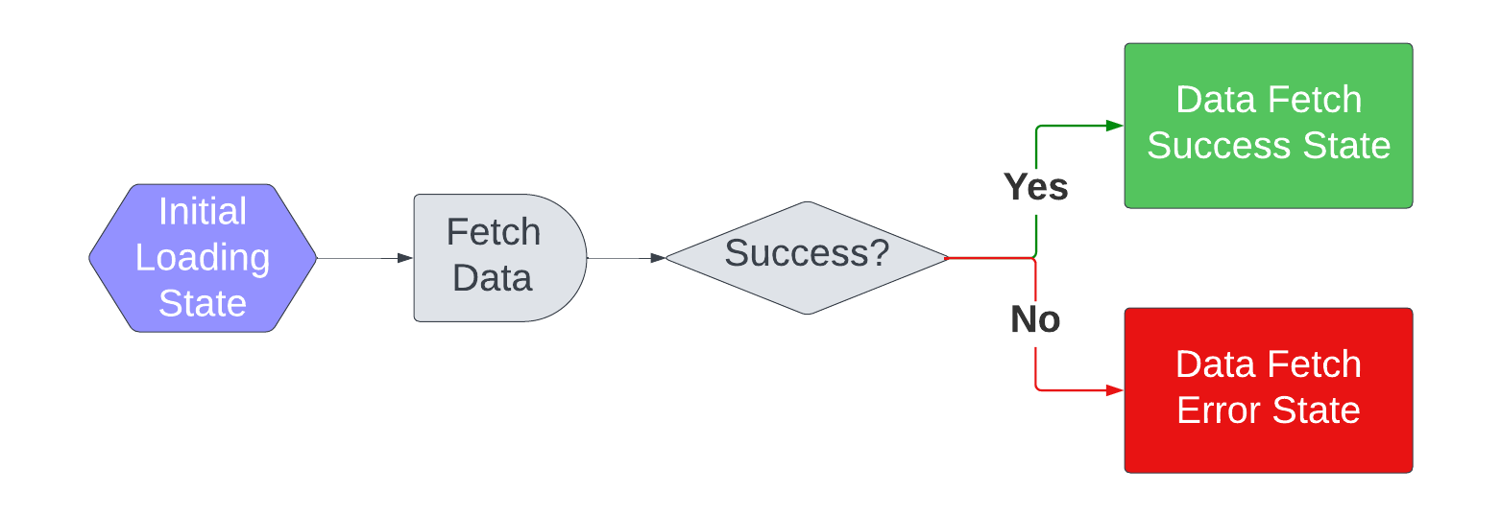
useReducer Example: Data Fetching
Notes:
Reducer holds states – loading, success, error

Slide 13
useReducer Example: In a Custom Hook “useCollection”
Fetch data
Store state in reducer
Return state
Notes:
Complicated reducers are best handled in a custom hook, and/or context.

Slide 14
useReducer Example: Data Fetching
Reducer function is often a pure function with a switch statement.
function loadingReducer(state, action) { switch (action.type) {
case 'response': return { data: action.response, status: 'loaded', error: null, } } }
case 'error': return { data: null, status: 'error', error: action.error, }
case 'loading': return { data: null, status: 'loading', error: null, }
Data Fetch Success
Data Fetch Error
Initial Loading State
Notes:
“Pure” just means no side effects. Don’t do data fetching inside the reducer; instead you will update state in the reducer.

Slide 15
useReducer: 1. Initialize
State: Interconnected state is all in one object
Dispatch: Function for changing state
const [state, dispatch] = useReducer(loadingReducer, { data: null, status: 'loading', error: null, })
Initial State
(Loading in this example)
Initialization can also happen in a function
Notes:
If you have a complex reducer, you’ll most likely want to use the function option for Initializing the reducer

Slide 16
useReducer: 2. Change State
Handle response and error states
Handle Response State
getCollectionDetails(collectionId) .then((response) => { dispatch({ type: 'response', response }) }) .catch((error) => { dispatch({ type: 'error', error }) })
Handle Error State

Slide 17
useReducer: 3. Use in Custom Hook
Custom Hook Name: “use…”
export function useCollection({collectionId}) { const [state, dispatch] = useReducer(loadingReducer, { data: null, status: 'loading', error: null, }) useEffect(() => { let cancelled = false // Get the data and handle success/error appropriately getCollectionDetails({ collectionId }) …. return () => { cancelled = true } }, [collectionId]) return [state.data, state.status, state.error] }
Call useReducer
Do a thing, call “dispatch” to change state
Return state from custom hook

Slide 18
useReducer: 4. Use Custom Hook
Call custom hook for reducer states
const [collection, status, error] = useCollection(collectionId)
if (error) { return <UnknownError /> } if (status === 'loading') return <Skeleton /> } return <Component collection={collection} />
Handle each state in UI
Notes:
Complicated reducers are best handled in a custom hook, and/or context.
You can always expose functions that trigger one of the dispatches

Slide 19
useReducer: Basic Unit Testing
Test every UI case in a unit test. In our example:
Loading
Error
Data Loaded
test('renders not found page for invalid collection ID’, async () => { render(<CollectionDetailsRoute collectionId="bogusCollectionId" />) const notFound = await screen.findByText(‘not found') expect(notFound).toBeInTheDocument() })

Slide 20
useReducer: Complex Unit Tests
useReducer itself is part of the UI framework.
Move complex logic into separate functions, test those independently
If you need to test your reducer independently of UI:
Option 1: A fake UI
Make a component that displays state
Then, test the sample component
This allows you to set up a more testable UI
Option 2: Use react-hooks-testing-library

Slide 21
useReducer: Best for interconnected state
Diagram Example to come
Notes:
useReducer is a really good choice for interconnected state. We use reducers a lot in Source Linker.

Slide 22
React State Buckets
Contexts
URL query string
Local storage
API/Browser network cache
Custom Hooks

Slide 23
Custom Hooks are kinda sorta state buckets…
Combine various similar state data
Possibly use Contexts
Possibly use other custom hooks
function useRecordInfo() { const { father, mother, children } = useRecordFamily() const { recordName, recordURL} = useRecordData() return { father, mother, children, recordName, recordURL } }
Return an organized state object
Maybe return functions to change state outside hook

Slide 24
Contexts
Broadcast/share state among child components
Context Provider
Context Consumer
Context Consumer

Slide 25
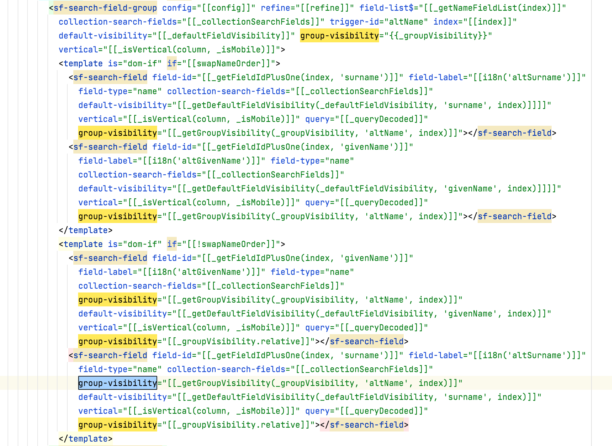
Contexts help us avoid prop drilling
Notes:
Polymer required prop drilling, and our HTML layouts were awful!
- Adding a prop required adding it everywhere
- Modifying something was a major chore

Slide 26
Contexts are not state managers
But contexts can contain state managers.
You still need to decide how to organize state variables inside your context bucket:
Props
Derived State
useState
useReducer

Slide 27
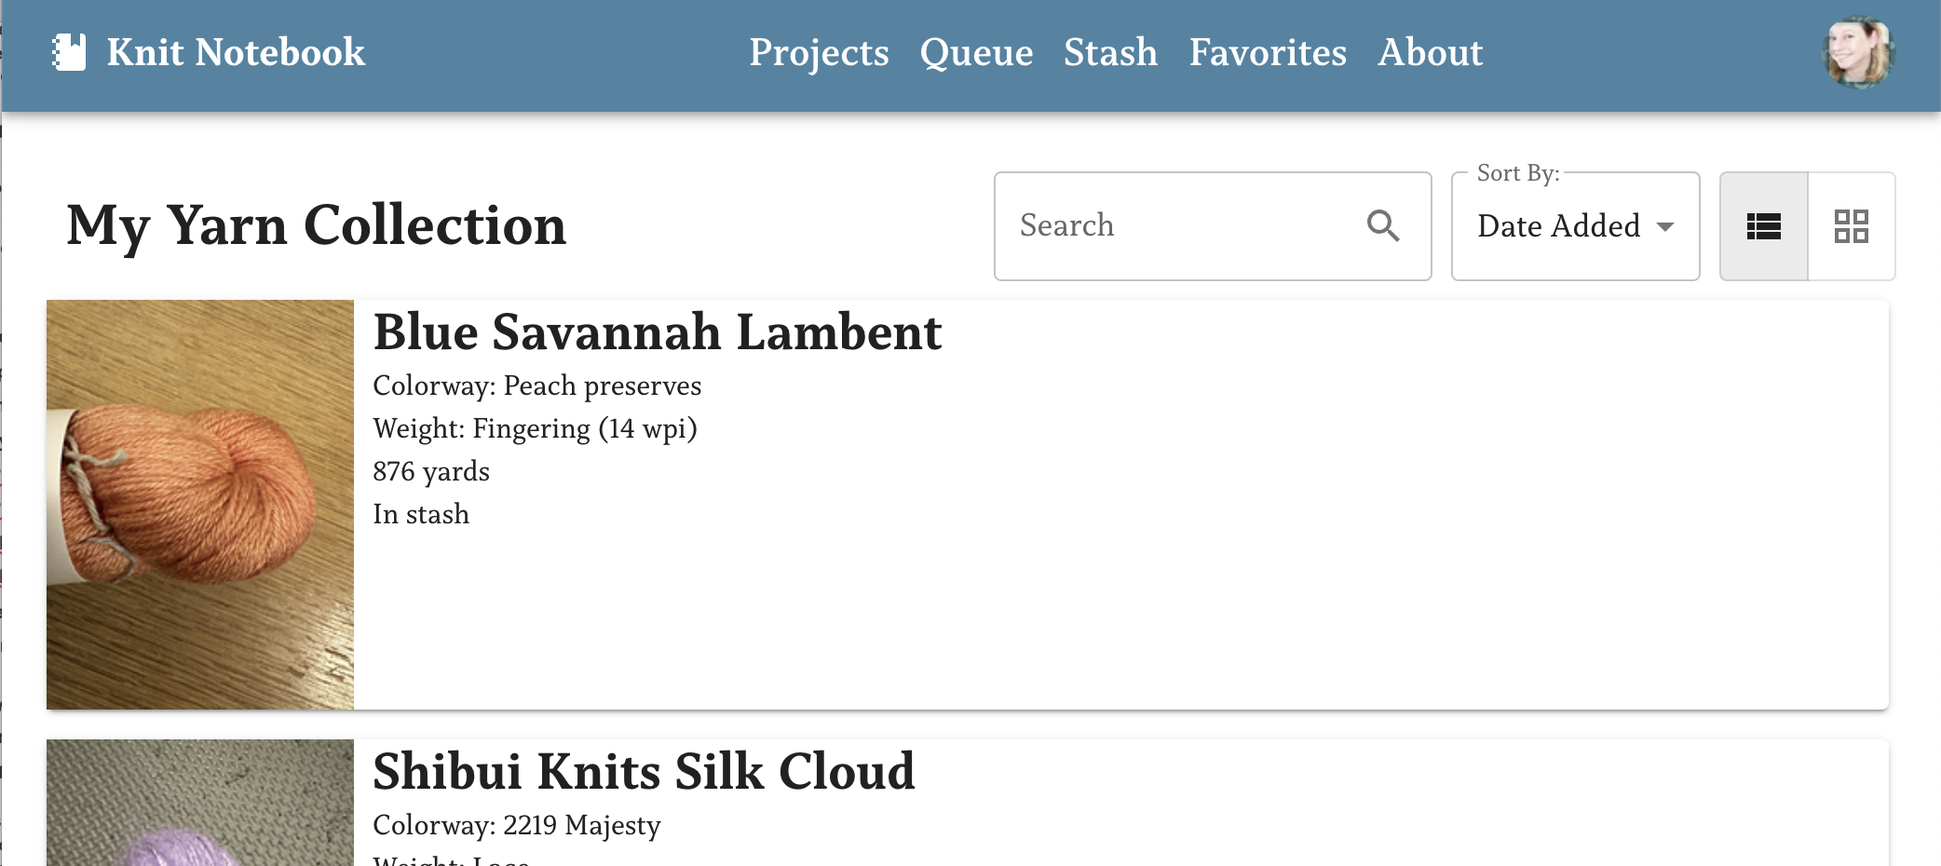
Example: Results Display Preferences
Users can set preferences for how they want their search results to appear
…. over there!
This is the perfect situation for a context!

Slide 28
Example: DisplayPrefsProvider
Create variable using createContext()
import { createContext } from "react" const DisplayPrefsContext = createContext({})
export default function DisplayPrefsProvider({ initialPrefs, children }) {
const [displayPrefs, setDisplayPrefs] = useState( initialPrefs || { resultsStyle: "list" } )
Export Provider component
return ( <DisplayPrefsContext.Provider value={{ displayPrefs, setDisplayPrefs }}> {children} </DisplayPrefsContext.Provider> )}
Return JSX
with provider & children

Slide 29
Example: DisplayPrefsProvider
Export custom hook for accessing & updating context
export function useDisplayPrefs() { const { displayPrefs, setDisplayPrefs} =
useContext(DisplayPrefsContext) return { displayPrefs, setDisplayPrefs}
}
Hook uses context directly

Slide 30
Example: Using DisplayPrefsProvider
Context hooks are not available in this component!
export default function SearchForm({ initialPrefs }) {
return ( <DisplayPrefsProvider initialPrefs={initialPrefs}> <DisplayPrefOptions /> </DisplayPrefsProvider> )}
const [prefs, setPrefs] = useDisplayPrefs()
A component brings in the provider
Context hooks are available inside children.

Slide 31
Example: Using DisplayPrefsProvider
Child component uses the hook
function DisplayPrefsOptions() { const [prefs, setPrefs] = useDisplayPrefs() return ( <Button onClick={() => { setPrefs((p) => !p.moreOptions) }} > {prefs.moreOptions ? 'Fewer Options' : 'More Options'} </Button> ) }
Make changes to the context by calling a function in the hook

Slide 32
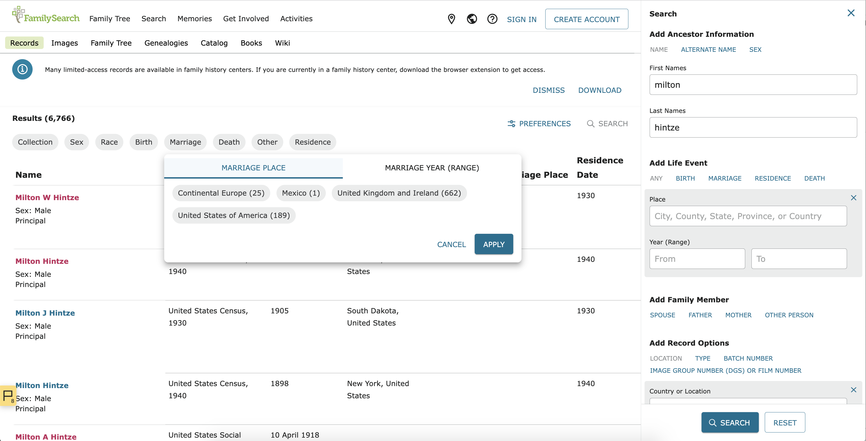
Organizing Contexts: Search Results
Search Results has top-level contexts
The search form has its own context
\
Filters have their own context!
ICS CON 2023

Slide 33
Contexts Pro Tip: Calculate before Storing
Do expensive calculations in the context component
If you do an expensive calculation a custom hook, every time the hook is used, you re-calucate.

Slide 34

Composition
Organizing components & custom hooks into a cohesive application

Slide 35
Composition Building Blocks
Display Components
Context Components
Custom Hooks
Non-React Functions

Slide 36
Composition using Contexts
Focus on state data & state management
Break complex context components up into smaller components as necessary
Put each context at the lowest possible level
Create appropriate custom hooks

Slide 37
Composition using Display Components
Move logic to custom hooks or context components
Focus on the UI

Slide 38
Composition using Custom Hooks
Some will be single-purpose
Some will be generic and reusable
Components can use multiple hooks

Slide 39
Organizing Custom Hooks
For example, one component could include separate hooks by function:
Handle URL management
Handle analytics
Handle display preferences
Etc.

Slide 40
Composition using Non-React Functions
Move complex logic into their own functions
Break logic into smaller functions as needed
functions can be unit-tested in isolation

Slide 41

React’s “Single Source of Truth” Principle
Data has one source of truth
Data only flows down

Slide 42
What does this “one way” principle mean?
Two similar variables should not try and keep each other in sync
State should live at the top of where it is needed
Functions to change state are passed down
If another variable is similar:
Use derived state
Set the related variable lower, based on the main variable
Set the two variables at the same time (use a reducer)

Slide 43
Combining the building blocks

Slide 44
How to Start a Complex Project
Find the foundation of the big project – what to do first?
Fetch some data, create a provider and a component.
Write unit tests.
Add more features, piece by piece.
Refactor frequently to keep the code maintainable.
As soon as possible, split up the work among everyone on your team!
Notes:
Get Peer reviews as often as possible

Slide 45
Organize your data as you add features
Separate complex data structures into multiple contexts
Break up “sections” of code into custom hooks
Break up components when they get complicated

Slide 46
Sample context organization: Search Results
Main Form State
Faceted Filter State
User-Defined Display Preferences
Results Decoration data
Notes:
Form State: User-defined form state, such as expanded sections; are we looking at a form inside search results? Does it look different?
Faceted Filter State: What filters have the user expanded? chosen?
User-defined display preferences:
Table, List, Large Thumbnails, Small Thumbnails, Lots of info, Less info
Results decoration data: any extra network we calls we make later and decorate the data with (how many sales the last week, how many favorites, etc.)

Slide 47
Diagrams
Diagrams are very useful! You can diagram data, algorithms, and components.
When we work on code, we build a mental model of our components.
That works great while we are actively working on it, but later… it helps to have diagrams to help rebuild our mental models.
When we bring a new person onto the team, diagrams become training tools.
Following are diagrams Search Web made and what they show about how we organized our code.
Notes:
Genealogical records with indexes are easier to navigate…So diagrams make code easier to navigate--

Slide 48
Organizing Components

Slide 49
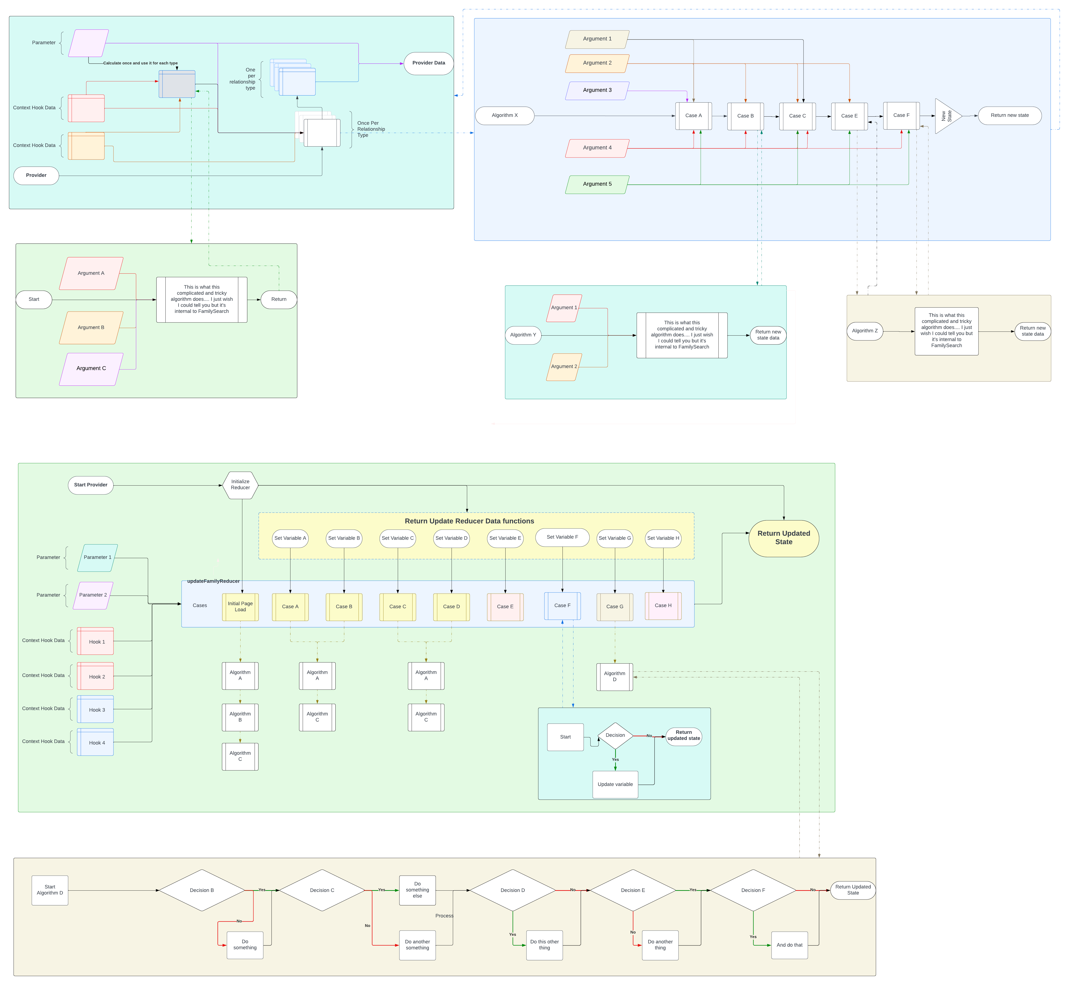
Organizing Algorithms

Slide 50
The following slides will become a live demo…

Slide 51
Sample custom hook organization:
I looked at a custom hook with many lines and found:
4 lines of Random stuff
2 lines to read the query string
3 lines of drag & drop
28 lines of an algorithm
16 lines of another algorithm
18 lines of highlighting
Notes:
If I had made 5 contexts – or even 3 – the custom hook would have been much easier to read

Slide 52
Sample of Simplifying JSX – Make new components!
return ( <DataPreview.Provider loading={status === 'loading'} error={status === 'error'}> <DataPreview.Loading>{/* 9-line loading skeleton*/}</DataPreview.Loading> <DataPreview.Ready>{/* 93-line data section */}</DataPreview.Ready> <DataPreview.Error> <UnknownError /> </DataPreview.Error> </DataPreview.Provider> )
Make new components with obvious “sections”

Slide 53
Start with state closest to where you need it, then refactor

Slide 54
Putting it all together with an example
Knit Notebook
Ravelry API
Refactoring

Slide 55

Wrapping Up
I hope this presentation has given you ideas and tools for managing complex state in React.
For slides:
See QR code
Email mary.shaw@familysearch.org
Ask in UtahJS Slack: marybeshaw
Notes:
TODO: QR CODE

